Slide 1

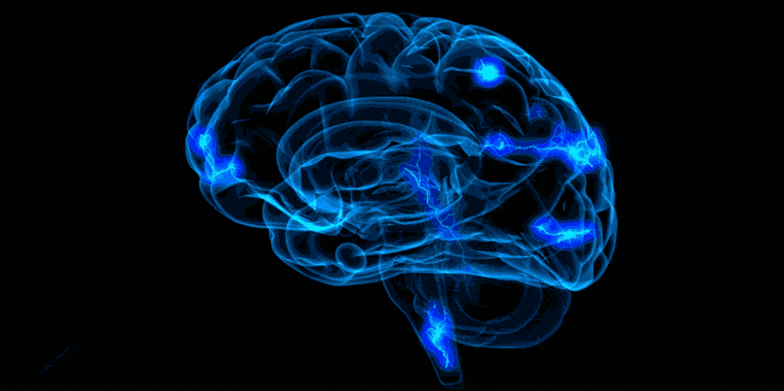


practical learning redefined
One point solution for all your placement needs
terv.pro

Slide 2
















LAND YOUR
DREAM JOB

Slide 3
{
{

Slide 4
FOLLOW THE COMMANDS

Slide 5
STAND UP

Slide 6
CLAP TWICE

Slide 7
SIT DOWN

Slide 8

Repeat after me…

Slide 9
LIGHTS OFF!

Slide 10

MACHINE
HUMAN

Slide 11
01010111 01000101 01001100 01000011 01001111 01001101 01000101 00100000 01010100 01001111 00100000 01001110 01000101 01010111 00100000 01000001 01000111 01000101 00100000 01001100 01000101 01000001 01010010 01001110 01001001 01001110 01000111 00101110 00100000 01010000 01010010 01000001 01000011 01010100 01001001 01000011 01000001 01001100 00100000 01001100 01000101 01000001 01010010 01001110 01001001 01001110 01000111 00100000 01010010 01000101 01000100 01000101 01000110 01001001 01001110 01000101 01000100 00100000 00101101 00100000 01010100 01000101 01010010 01010110 00101110
WELCOME TO NEW AGE LEARNING. PRACTICAL LEARNING REDEFINED - TERV.

Slide 12



HOW TO COMMUNICATE?

Slide 13



PROGRAMING LANGUAGE

Slide 14

__
Become ‘The Programmer’ and This will be your Personal Home Locker!

Slide 15

Why programmers are paid more?

Slide 16

LOGIC

Slide 17


CUBE-1
CUBE-2

Slide 18

1
31

Slide 19
CONDITIONS
Given 2 Cubes
Given 1 marker
Write one “single digit” number per face
Show any number in the range of 1 to 31
Always represent a number with both the cubes – (Even for single digit number)

Slide 20
0
1
2
3
4
5
CUBE-1
0
1
2
6
7
8
CUBE-2

Slide 21

Q-1
ITERATOR
Given a number N followed by N integers, it will comprise of certain positive numbers, then a zero then follows negative numbers. Find the minimum number of iterations to convert a Positive-Zero-Negative array into a Negative-Zero-Positive array, by abiding by the given constraints.
Constraints for Swapping:
1. Swapping is possible only with a Zero
2. A positive number should be swapped only to the right hand side
3. A negative number should be swapped only to the left hand side
4. Swapping can be done to a maximum of two steps at a time.
Difficulty
Find the minimum number of iterations.

Slide 22
Q-1
ITERATOR
1
2
3
0
-4
-5
-6

Slide 23


Q-1
CONSTRAINT - 1
1
2
3
0
-4
-5
-6
1
2
3
0
-4
-5
-6

Slide 24
Q-1
CONSTRAINT - 2
1
2
3
0
-4
-5
-6
1
0
3
2
-4
-5
-6

Slide 25
Q-1
CONSTRAINT - 3
1
2
3
0
-4
-5
-6
1
2
3
-5
-4
0
-6

Slide 26
Q-1
CONSTRAINT - 4
}
2
}
1
2
3
0
-4
-5
-6
3
1
2
3
-5
-4
0
-6

Slide 27

Q-1
CONSTRAINTS
Swapping is possible only with a Zero
2. A positive number should be swapped only to the right hand side
3. A negative number should be swapped only to the left hand side
4. Swapping can be done to a maximum of two steps at a time.

Slide 28
Q-1
SAMPLE INPUT
1
0
-3
}
OUTPUT
0
1
-3
3
-3
1
0
-3
0
1

Slide 29

Q-1
FIND THE OUTPUT
6P
0
7N

Slide 30
Q-1
FIND THE OUTPUT
1P
0
1N
3
2P
0
1N
5
?
2P
0
2N
8
?
6P
0
7N
55
?

Slide 31

Q-1
SOLUTION
P * N + ( P + N )
</CODE>

Slide 32
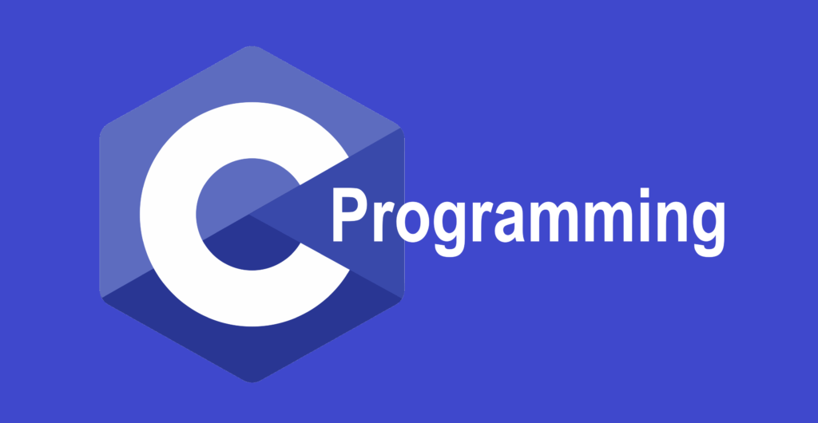

Slide 33
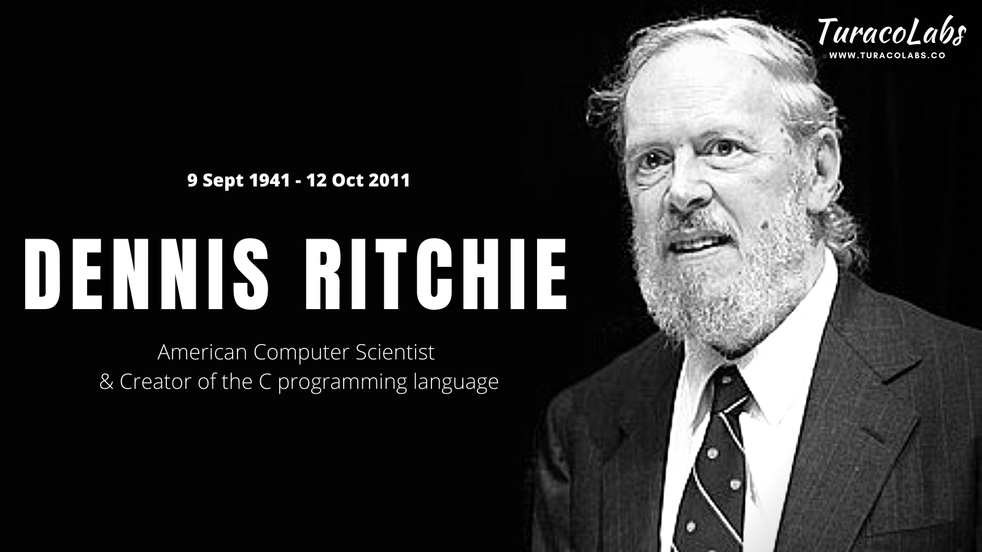

Slide 34




Notes:
All top CEOs are waiting to hire people who knew the history of C and who found it. Great work memorizing it!

Slide 35
FIRST C PROGRAM
#include <stdio.h>
int main()
{
printf("Hello Terv Learners!");
return 0;
}
Header File
Main Function
Output Statement

Slide 36

COOKING
Notes:
While cooking, do we bring the prepare the ingredients before we start cooking or only after we start cooking we will run for buying the ingredients? Obviously we prepare everything before we start cooking. The same happens with programming. Here that work is done with the help of pre-processor directives.

Slide 37

PRE-PROCESSOR DIRECTIVES
The term “preprocessor” is self-explanatory. The word “pre” means “before” and the word “processor” refers to “making something”. Before the source code is compiled, it gets automatically processed due to the presence of preprocessor directives.

Slide 38
C - Source Code
C - Program
Object Code
Executable code
Are there pre-processor directives
No
Compiler
Linker
Yes
Pre-processor perform action
PRE-PROCESSORS

Slide 39
TYPES OF PRE-PROCESSOR DIRECTIVES
01
02
03
04
MACROS
FILE INCLUSION
CONDITIONAL COMPILATION
OTHER DIRECTIVES
Object like Macro
Function like Macro
Standard Header File Inclusion
User defined Header file Inclusion
#if
#ifdef
#ifndef
#else
#elif
#endif
#defined
#undef
#pragma

Slide 40

OBJECT LIKE MACROS
#define TERV 100
Token
NOTE
By convention, macro names are written in uppercase.
Abbreviation
Create Macros
Notes:
Token – A compiler breaks the program into smallest possible units and that smallest possible unit is called as a Token.

Slide 41
FUNCTION LIKE MACROS
#define sum(a,b) a+b
Definition
NOTE
You can define a function with arguments passed into it.
Function call
Create Macros

Slide 42
Convert a macro parameter into a string using Stringize operator(#)
#
#include <stdio.h>
#define statement(i) \
printf(#i ": Macro Stringize!\n")
int main() {
statement(Terv Pro);
return 0;
Stringize
Notes:
Terv Pro: Macro Stringize!

Slide 43
TOKEN PASTING OPERATOR
##
#include <stdio.h>
#define concat(a, b) a##b
int main(void)
{
int xy = 30;
printf("%d", concat(x, y));
return 0;
}
Token pasting operator
Notes:
Allows tokens used as actual arguments to be concatenated to form other tokens. It is often useful to merge two tokens into one while expanding macros. This is called token pasting or token concatenation. The ‘##’ pre-processing operator performs token pasting. When a macro is expanded, the two tokens on either side of each ‘##’ operator are combined into a single token, which then replaces the ‘##’ and the two original tokens in the macro expansion.

Slide 44
TOKEN PASTING OPERATOR
##
#include <stdio.h>
#define concat(x, y) x##y
int main(void)
{
int xy = 30;
printf("%d", concat(x, y));
return 0;
}
Token pasting operator
Notes:
Allows tokens used as actual arguments to be concatenated to form other tokens. It is often useful to merge two tokens into one while expanding macros. This is called token pasting or token concatenation. The ‘##’ pre-processing operator performs token pasting. When a macro is expanded, the two tokens on either side of each ‘##’ operator are combined into a single token, which then replaces the ‘##’ and the two original tokens in the macro expansion.

Slide 45
TOKEN PASTING OPERATOR
##
#include <stdio.h>
#define concat(x, y) x##y
int main(void)
{
int xy = 30;
printf("%d", xy);
return 0;
}
Token pasting operator
Notes:
Allows tokens used as actual arguments to be concatenated to form other tokens. It is often useful to merge two tokens into one while expanding macros. This is called token pasting or token concatenation. The ‘##’ pre-processing operator performs token pasting. When a macro is expanded, the two tokens on either side of each ‘##’ operator are combined into a single token, which then replaces the ‘##’ and the two original tokens in the macro expansion.

Slide 46
TOKEN PASTING OPERATOR
##
#include <stdio.h>
#define concat(x, y) x##y
int main(void)
{
int xy = 30;
printf("%d", 30);
return 0;
}
OUTPUT
30
Token pasting operator
Notes:
Allows tokens used as actual arguments to be concatenated to form other tokens. It is often useful to merge two tokens into one while expanding macros. This is called token pasting or token concatenation. The ‘##’ pre-processing operator performs token pasting. When a macro is expanded, the two tokens on either side of each ‘##’ operator are combined into a single token, which then replaces the ‘##’ and the two original tokens in the macro expansion.

Slide 47
Why Macros?
You can use macros to create automatic loop unrolling
Loop Unrolling:
Normal Loop | After Loop Unrolling
int x; for (x = 0; x < 100; x++) { delete(x); } | int x; for (x = 0; x < 100; x += 5 ) { delete(x); delete(x + 1); delete(x + 2); delete(x + 3); delete(x + 4); }
100
20
Notes:
As a result of this modification, the new program has to make only 20 iterations, instead of 100. Afterwards, only 20% of the jumps and conditional branches need to be taken, and represents, over many iterations, a potentially significant decrease in the loop administration overhead. To produce the optimal benefit, no variables should be specified in the unrolled code that require pointer arithmetic. This usually requires "base plus offset" addressing, rather than indexed referencing.

Slide 48
Unrolling WHILE loops
Normal Loop | After Loop Unrolling | Unrolled and “tweeked” loop
WHILE (condition) DO action ENDWHILE | WHILE (condition) DO action IF NOT(condition) THEN GOTO break action IF NOT(condition) THEN GOTO break action ENDWHILE LABEL break: | IF (condition) THEN REPEAT action IF NOT(condition) THEN GOTO break action IF NOT(condition) THEN GOTO break action WHILE (condition) LABEL break:
Notes:
In this case, unrolling is faster because the ENDWHILE (a jump to the start of the loop) will be executed 66% less often.
Even better, the "tweaked" pseudocode example, that may be performed automatically by some optimizing compilers, eliminating unconditional jumps altogether.

Slide 49
PREDEFINED MACROS
PREDEFINED MACROS
MACRO
FUNCTION
__DATE__
Current date as MM DD YYYY format
__TIME__
Current Time in HH:MM:SS format
__FILE__
Contains current file name
__LINE__
Contains current line number
__STDC__
Defined as 1when the compiler compiles

Slide 50
MACROS
PROGRAM
OUTPUT
#include <stdio.h>
int main() {
printf("Terv: Predefined Macros!\n\n");
char filename[] = __FILE__;
char date[] = __DATE__;
char time[] = __TIME__;
int line = __LINE__;
int ansi = __STDC__;
printf("File name is: %s\n", filename);
printf("Date is: %s\n", date);
printf("Now time is: %s\n", time);
printf("Current line number: %d\n", line);
printf("Compilation Success: %d\n", ansi);
}
Notes:
Terv: Predefined Macros! File name is: main.c Date is: Jan 03 2022 (specify the current date) Now time is: 09:47:33 Current line number: 15 Compilation Success: 1

Slide 51
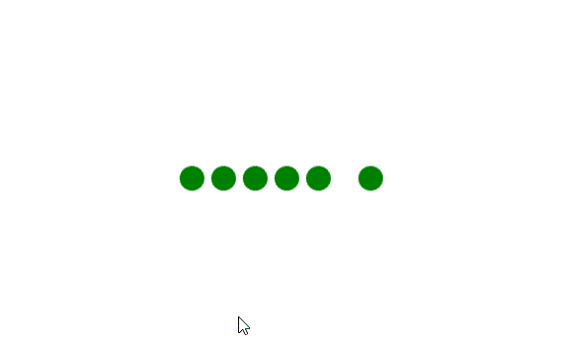
MACROS
PROGRAM
OUTPUT
RUN
#include<stdio.h> #define TERV 100
int main()
{
printf(“%d”,TERV);
return 0;
}
100
Notes:
100

Slide 52
MACROS
PROGRAM
OUTPUT
RUN
#include <stdio.h>
#define max 100
int main ()
{
#define max 50
int a= max;
printf("%d", a);
return 0;
}
50
Notes:
50

Slide 53

FILE INCLUSION

Slide 54
FILE INCLUSION
This type of preprocessor directives insert the entire contents of file into the source program.
Two Cases:
For large program where we divide it into the smaller programs (files)
If similar functions and macro definitions are using frequently
1. Header files or standard files
These files contains definition of pre-defined functions like printf(), scanf() and sqrt() so on stored in stdio.h and math.h header files. syntax: #include <file_name>
The ‘<‘ and ‘>’ brackets tells the compiler to look for the file in standard directory.
2. User Defined files
When a program becomes very large, it is good practice to divide it into smaller files and include whenever needed. These types of files are user defined files.
syntax: #include “file_name“
It tells compiler to look for the file in specified directory. If path is not defined with file name then it will search for that file in the same directory where the main program file exists. Also we define multiple path location separated by semicolon (;).

Slide 55
FILE INCLUSION
PRIMARY.c
circle.c
#include<stdio.h>
#include "circle.c"
#include "circle.h"
int main()
{
float r = 4.0;
printf("%.2f", circle_area(r, PI));
return 0;
}
double circle_area(float r, float PI)
{
return (PI * r * r);
}
circle.h
#define PI 3.14159265358979323846
double circle_area(float, float);
OUTPUT: 50.27
Notes:
circle.c This file has definition of the function/methods.
circle.h This file has all the macro definitions and function declaration (prototypes).
PRIMARY.c This is our main C program where we include circle.h file. By including this file we also include macro definition for PI and also the function to calculate area of circle.
Note: Make sure PRIMARY.c, circle.c and circle.h are all in the same directory/folder or you defined a proper path for all of them.

Slide 56
CONDITIONAL COMPILATION
PROGRAM
#ifdef
#if
#ifndef
defined
#else
#endif
#elif
Notes:
50

Slide 57
#undef
PROGRAM
The #undef directive tells the preprocessor to remove all definitions for the specified macro. A macro can be redefined after it has been removed by the #undef directive.
SYNTAX: #undef macro_definition
Once a macro is undefined, an #ifdef directive on that macro will evaluate to false.

Slide 58
#pragma
PROGRAM
This directive is a special purpose directive and is used to turn on or off some features. This type of directives are compiler-specific i.e., they vary from compiler to compiler.
#pragma startup and #pragma exit
#pragma warn directive
#pragma GCC poison
#pragma GCC dependency
#pragma GCC system_header
#pragma once

Slide 59



#pragma startup and pragma exit
*STUDENT
PROGRAM
These directives helps us to specify the functions that are needed to run before program startup( before the control passes to main()) and just before program exit (just before the control returns from main()).
PROGRAM EXCECUTION STARTS WITH THE MAIN FUNCTION
*C-LANGUAGE
*PRAGMA
*STUDENT
EVERYTHING I KNEW ABOUT PROGRAMMING WAS WRONG
AM I A JOKE TO YOU

Slide 60

#pragma startup and pragma exit
#include<stdio.h>
void func1();
void func2();
#pragma startup func1
#pragma exit func2
void func1()
{
printf("Inside func1()\n");
}
void func2()
{
printf("Inside func2()\n");
}
int main()
{
printf("Inside main()\n");
return 0;
}
stdio.h
func1
Inside func1()
Inside main()
main
Inside func2()
func2
NOTE: THIS WILL NOT BE THE OUTPUT IN GCC COMPILERS AS GCC DOES NOT SUPPORT PRAGMA STARTUP AND PRAGMA EXIT
Notes:
Inside main() Only this is the output in GCC compiler

Slide 61
ACHIEVE THE SAME RESULT IN GCC
#include<stdio.h>
void func1();
void func2();
void __attribute__((constructor)) func1();
void __attribute__((destructor)) func2();
void func1()
{
printf("Inside func1()\n");
}
void func2()
{
printf("Inside func2()\n");
}
int main()
{
printf("Inside main()\n");
return 0;
}
__attribute__((constructor)) syntax : This particular GCC syntax, when used with a function, executes the same function at the startup of the program, i.e before main() function.
__attribute__((destructor)) syntax : This particular GCC syntax, when used with a function, executes the same function just before the program terminates through _exit, i.e after main() function.
OUTPUT:
Inside func1()
Inside main()
Inside func2()

Slide 62
#pragma warn directive
PROGRAM
This directive is used to hide the warning messages which are displayed during compilation. This may be useful for us when we have a large program and we want to solve all the errors before looking on warnings then by using it we can focus on errors by hiding all warnings. we can again let the warnings be visible by making slight changes in syntax.
SYNTAX:
#pragma warn +xxx (To show the warning)
#pragma warn -xxx (To hide the warning)
#pragma warn .xxx (To toggle between hide and show)

Slide 63
#pragma warn directive
#pragma warn -rvl:
This directive hides those warning which are raised when a function which is supposed to return a value does not return a value.
PROGRAM
#pragma warn -par:
This directive hides those warning which are raised when a function does not uses the parameters passed to it.
#pragma warn -rch:
This directive hides those warning which are raised when a code is unreachable. For example: any code written after the return statement in a function is unreachable.

Slide 64
#pragma warn directive
PROGRAM
#include<stdio.h>
#pragma warn -rvl /* return value */
#pragma warn -par /* parameter never used */
#pragma warn -rch /*unreachable code */
int show(int x)
{
// parameter x is never used in
// the function
printf(“TERVPRO");
// function does not have a
// return statement
}
int main()
{
show(10);
return 0;
}
This program compiles successfully without any warnings to give the output “TERVPRO”.
OUTPUT
TERVPRO

Slide 65

#pragma GCC dependency
The #pragma GCC dependency allows you to check the relative dates of the current file and another file. If the other file is more recent than the current file, a warning is issued. This is useful if the current file is derived from the other file, and should be regenerated.
PROGRAM
Syntax:
#pragma GCC dependency "parse.y"
#pragma GCC dependency "/usr/include/time.h" rerun fixincludes

Slide 66
#pragma GCC poison
#include<stdio.h>
#pragma GCC poison printf
int main()
{
int a=10;
if(a==10)
{
printf("GEEKSFORGEEKS");
}
else
printf("bye");
return 0;
}
This directive is supported by the GCC compiler and is used to remove an identifier completely from the program. If we want to block an identifier then we can use the #pragma GCC poison directive.
PROGRAM
prog.c: In function 'main':
prog.c:14:9: error: attempt to use poisoned "printf"
printf("GEEKSFORGEEKS");
^
prog.c:17:9: error: attempt to use poisoned "printf"
printf("bye");
^
OUTPUT

Slide 67
LETS LIST OUT THINGS THAT WE NEED TO PLAY!
CRICKET
FOOTBALL
CHESS
Bat
Football
Board
Ball
Gloves
Coins
Stumps
Boots
Timer
Gloves
Helmet
Shoes

Slide 68
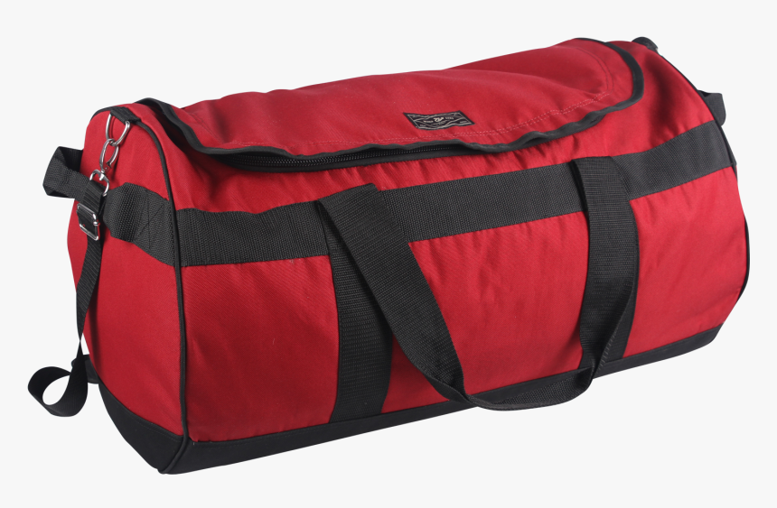
LETS LIST OUT THINGS THAT WE NEED TO PLAY!
CRICKET
FOOTBALL
CHESS
Bat
Football
Board
Ball
Gloves
Coins
Stumps
Boots
Timer
Gloves
Helmet
Shoes

Slide 69


This much just for a chess game?

Slide 70
MEMORY
WEIGHT

Slide 71
TIME
TIME

Slide 72
GROUP SIMILAR THINGS TOGETHER
CRICKET KIT
FOOTBALL KIT
CHESS KIT
STDIO.H
STRING.H
MATH.H

Slide 73
HEADER FILES
Header files contain “the set of predefined standard library functions”
Function definitions
Data type definitions
Macros
Header Files
Pre-Existing
User Defined

Slide 74
TYPES OF HEADER FILES
Pre-existing header files: Files which are already available in C/C++ compiler we just need to import them.
Syntax:
#include <filename.h>
User-defined header files: These files are defined by the user and can be imported using “#include”.
Syntax:
#include "filename.h"
Note: We can’t include the same header file twice in any program.
Notes:
We can include header files in our program by using one of the above two syntax whether it is pre-defined or user-defined header file. The “#include” preprocessor is responsible for directing the compiler that the header file needs to be processed before compilation and includes all the necessary data type and function definitions.

Slide 75
CREATING YOUR OWN HEADER FILE
circle.h
PRIMARY.c
#define PI 3.14159265358979323846
double circle_area(float, float);
#include<stdio.h>
#include "circle.c"
#include "circle.h"
int main()
{
float r = 4.0;
printf("%.2f", circle_area(r, PI));
return 0;
}
circle.c
double circle_area(float r, float PI)
{
return (PI * r * r);
}
OUTPUT: 50.27
Note: We can’t include the same header file twice in any program.
Notes:
Instead of writing a large and complex code, we can create your own header files and include them in our program to use it whenever we want. It enhances code functionality and readability.

Slide 76

INCLUDING MULTIPLE HEADER FILES
You can use various header files in a program. When a header file is included twice within a program, the compiler processes the contents of that header file twice. This leads to an error in the program. To eliminate this error, conditional preprocessor directives are used.
Syntax:
#ifndef HEADER_FILE_NAME
#define HEADER_FILE_NAME
the entire header file
#endif
Note: We can’t include the same header file twice in any program.
Notes:
Instead of writing a large and complex code, we can create your own header files and include them in our program to use it whenever we want. It enhances code functionality and readability.

Slide 77
INCLUDING MULTIPLE HEADER FILES
This construct is called wrapper “#ifndef”. When the header is included again, the conditional will become false, because HEADER_FILE_NAME is defined. The preprocessor will skip over the entire contents of the file and the compiler will not see it twice.
Sometimes it’s essential to include several diverse header files based on the requirements of the program. For this, multiple conditionals are used.
Syntax:
#if SYSTEM_ONE
#include "system1.h"
#elif SYSTEM_TWO
#include "system2.h"
#elif SYSTEM_THREE
....
#endif

Slide 78
DIFFERENT HEADER FILES
#include<stdio.h> (Standard input-output header)
#include<signal.h> (Signal header)
#include<string.h> (String header)
#include<setjmp.h> (Jump header)
#include<conio.h> (Console input-output header)
#include<stdarg.h> (Standard argument header)
#include<stdlib.h> (Standard library header)
#include<errno.h> (Error handling header)
#include<math.h> (Math header )
#include<ctype.h>(Character type header)
#include<time.h>(Time header)
#include<assert.h> (Assertion header)
#include<locale.h> (Localization header)
Notes:
STDIO: Used to perform input and output operations in C like scanf() and printf().
STRING: Perform string manipulation operations like strlen and strcpy.
CONIO: Perform console input and console output operations like clrscr() to clear the screen and getch() to get the character from the keyboard.
STDLIB: Perform standard utility functions like dynamic memory allocation, using functions such as malloc() and calloc().
MATH: Perform mathematical operations like sqrt() and pow(). To obtain the square root and the power of a number respectively.
CTYPE: Perform character type functions like isaplha() and isdigit(). To find whether the given character is an alphabet or a digit respectively.
TIME: Perform functions related to date and time like setdate() and getdate(). To modify the system date and get the CPU time respectively.
ASSERT: It is used in program assertion functions like assert(). To get an integer data type in C/C++ as a parameter which prints stderr only if the parameter passed is 0.
LOCALE: Perform localization functions like setlocale() and localeconv(). To set locale and get locale conventions respectively.
SIGNAL: Perform signal handling functions like signal() and raise(). To install signal handler and to raise the signal in the program respectively
SETJMP: Perform jump functions.
STDARG: Perform standard argument functions like va_start and va_arg(). To indicate start of the variable-length argument list and to fetch the arguments from the variable-length argument list in the program respectively.
ERRNO: Used to perform error handling operations like errno(). To indicate errors in the program by initially assigning the value of this function to 0 and then later changing it to indicate errors.

Slide 79
FIRST C PROGRAM
FIRST C PROGRAM
DOCUMENTATION
#include <stdio.h>
int main()
{
printf(“Welcome Terv Learners");
return 0;
}
LINK SECTION
DEFINITION SECTION
GLOBAL DECLARATION SECTION
OUTPUT:
MAIN FUNCTION
Welcome Terv Learners
SUB PROGRAM SECTION
Notes:
Documentation Section
The documentation section is the part of the program where the programmer gives the details associated with the program. He usually gives the name of the program, the details of the author and other details like the time of coding and description. It gives anyone reading the code the overview of the code.
Link Section
This part of the code is used to declare all the header files that will be used in the program. This leads to the compiler being told to link the header files to the system libraries.
Definition Section
In this section, we define different constants. The keyword define is used in this part.
Global Declaration Section
This part of the code is the part where the global variables are declared. All the global variable used are declared in this part. The user-defined functions are also declared in this part of the code.
Main Function Section
Every C-programs needs to have the main function. Each main function contains 2 parts. A declaration part and an Execution part. The declaration part is the part where all the variables are declared. The execution part begins with the curly brackets and ends with the curly close bracket. Both the declaration and execution part are inside the curly braces.
Sample Program
The C program here will find the area of a circle using a user-defined function and a global variable pi holding the value of pi

Slide 80
KEYWORDS
Keywords are predefined, reserved words used in programming that have special meanings to the compiler.
BUT WHY!
Notes:
In computer science and computer programming, a data type or simply type is an attribute of data which tells the compiler or interpreter how the programmer intends to use the data. ... This data type defines the operations that can be done on the data, the meaning of the data, and the way values of that type can be stored.

Slide 81




I saw a beautiful girl at the beach yesterday!
You
are
so
beautiful!

Slide 82
I saw a beautiful girl at the beach yesterday!
You
are
so
you!

Slide 83
I saw a beautiful girl at the beach yesterday!
You
are
you
you!

Slide 84
I saw a beautiful girl at the beach yesterday!
You
you
you
you!

Slide 85
I saw a beautiful girl at the beach yesterday!
I should not use the reserved words for any else

Slide 86
32 - KEYWORDS
auto
break
case
char
const
continue
default
do
double
else
enum
extern
float
for
goto
if
int
long
register
return
short
signed
sizeof
static
struct
switch
typedef
union
unsigned
void
volatile
while

Slide 87






DATA TYPES IN C
WHAT IS DATA TYPE?
|
7
‘O’
Integer
Character
Photos
Videos
22.5
1.4377777
Float
Double
Docs
Zip
Notes:
In computer science and computer programming, a data type or simply type is an attribute of data which tells the compiler or interpreter how the programmer intends to use the data. ... This data type defines the operations that can be done on the data, the meaning of the data, and the way values of that type can be stored.

Slide 88
DATA TYPES IN C
DATA TYPES
PRIMITIVE TYPE
DERIVED TYPE
USER DEFINED TYPE
SIGNED
UNSIGNED
ARRAY
long double
char
int
Signed char
UnSigned char
struct
float / double
Signed short
UnSigned short
union
void
Signed int
UnSigned int
enum
Signed long
UnSigned long

Slide 89
INTEGER
The INTEGER data type stores whole numbers that range from -2,147,483,648 to 2,147,483,647 for 9 or 10 digits of precision.
4 BYTES
4,294,967,296
=
2³²
BUT WHY RANGE IS HALF?
NOTE: The number 2,147,483,648 is a reserved value and cannot be used.
Notes:
For that we need to know about modifiers.

Slide 90
INTEGER
KEYWORD: int
4 BYTES
NOTE: The number 2,147,483,648 is a reserved value and cannot be used.

Slide 91
INTEGER
4 BYTES
Sign BIT – The bit is used to denote whether the number is positive or negative
0 – positive
1 - negative
2,147,483,648
=
2³¹
NOTE: The number 2,147,483,648 is a reserved value and cannot be used.

Slide 92

WHY NEGATIVE HAS ONE MORE NUMBER?
-2,147,483,648
0
2,147,483,647
Notes:
Why negative has one more number in range as compared to positive? The answer is because of the computer itself. Since we have to store everything as binary, this condition prevails. The negative numbers are stored in binary by finding the two’s complement of the same number.

Slide 93
BINARY
÷
2
=
13
6
(Remainder 1)
Step 1: Divide the given decimal number by 2 and note down the remainder.
÷
6
2
=
3
Step 2: Now, divide the obtained quotient by 2, and note the remainder again.
(Remainder 0)
÷
Step 3: Repeat the above steps until you get 0 as the quotient.
3
2
=
1
(Remainder 1)
Step 4: Now, write the remainders in such a way that the last remainder is written first, followed by the rest in the reverse order.
÷
1
2
=
1
(Remainder 1)
Step 5: This can also be understood in another way which states that the Least Significant Bit (LSB) of the binary number is at the top and the Most Significant Bit (MSB) is at the bottom. This number is the binary value of the given decimal number.
1
1
0
1
Notes:
To understand that we have to first understand how a number is represented in the form of binary. Lets start with positive numbers.

Slide 94
BINARY OF NEGATIVE
10
1
0
1
0
1
0
1
0
1
1
0
1
1
0
Since we learnt about converting a decimal number to binary, now we can move on to our actual question.
Notes:
Find 1’s compliment and add 1

Slide 95

THE BIG ANSWER
Two’s Compliment Binary
Decimal
0111
+7
0110
+6
0101
+5
0100
+4
0011
+3
0010
+2
0001
+1
0000
0
1111
-1
1110
-2
1101
-3
1100
-4
1011
-5
1010
-6
1001
-7
1000
-8
Notes:
Are you so eager to know the answer? Just hold on. We shall see the answer in a couple of minutes!
Signed magnitude notation works, provided that the sign bit is treated separately from the magnitude of the number and guides how arithmetic operations are performed. However, arithmetic in this notation is difficult and results in some anomalies, such as two representations for zero (+0 is 0000 and -0 is 1000).
For n bits of storage the range of numbers that can be represented in two’s complement notation extends from negative 2 ^{n -1} to positive 2 ^{n - 1} –1. In figure 11.21 four bits of storage were used, so the range of numbers was from negative 2 ⁴⁻¹ ( i.e., - 2 ³ = -8 ) to positive 2 ⁴⁻¹ - 1 ( i.e., 2 ³- 1 = 8 –1 = 7 ). Most modern PCs use a “word” size of thirty-two bits to represent integers. Thus, they are capable of representing values in the range negative 2 ³¹ to positive 2 ³¹-1, or -2,147,483,648 to 2,147,483,647. Older computers used sixteen-bit words and were thus limited to representing integers in the range negative 2 ¹⁵ to positive 2 ¹⁵ – 1, or -32,768 to 32,767.

Slide 96
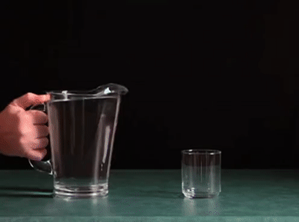
INTEGER OVERFLOW
DECLARATION:
int n = 5;
int n = 2,147,483,648;
How it works?

Slide 97
INTEGER OVERFLOW
-2,147,483,648
0
2,147,483,647

Slide 98
-2,147,483,648
2,147,483,647

Slide 99
-2,147,483,648
2,147,483,647

Slide 100
-2,147,483,648
2,147,483,647

Slide 101
-2,147,483,648
2,147,483,647

Slide 102
-2,147,483,648
2,147,483,647

Slide 103
-2,147,483,648
2,147,483,647

Slide 104
-2,147,483,648
2,147,483,647

Slide 105
-2,147,483,648
2,147,483,647

Slide 106
-2,147,483,648
2,147,483,647

Slide 107
-2,147,483,648
2,147,483,647

Slide 108
-2,147,483,648
2,147,483,647

Slide 109
-2,147,483,648
2,147,483,647

Slide 110
-2,147,483,648
2,147,483,647

Slide 111
-2,147,483,648
2,147,483,647

Slide 112
-2,147,483,648
2,147,483,647

Slide 113
-2,147,483,648
2,147,483,647

Slide 114
-2,147,483,648
2,147,483,647

Slide 115
int n = 2,147,483,648;
int n = -2,147,483,648;
-2,147,483,648
2,147,483,647
Notes:
When we try to increase a number over the limit or try to decrease the number over the limit, it just moves to the other side.

Slide 116
int n = -2,147,483,650;
int n = 2,147,483,646;
-2,147,483,648
2,147,483,647
Notes:
When we try to increase a number over the limit or try to decrease the number over the limit, it just moves to the other side.

Slide 117
INTEGER
int n = 5;
printf(“%d”,n);
OUTPUT:
5
`
int n = 5.1;
printf(“%d”,n);
OUTPUT:
5
`
int n = ‘c’;
printf(“%d”,n);
OUTPUT:
99
`
warning: initialization makes integer from pointer without a cast [-Wint-conversion]
int n = "c";
int n = “c”;
printf(“%d”,n);
OUTPUT:
4195812
`

Slide 118

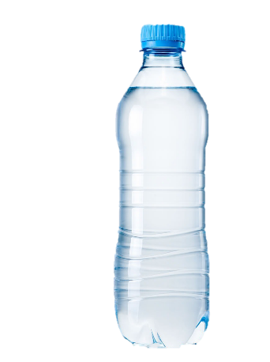
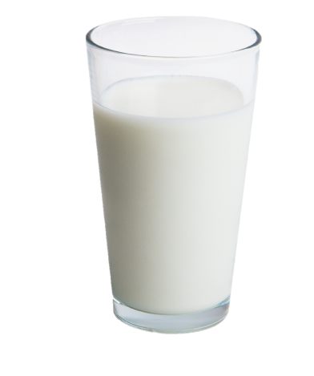
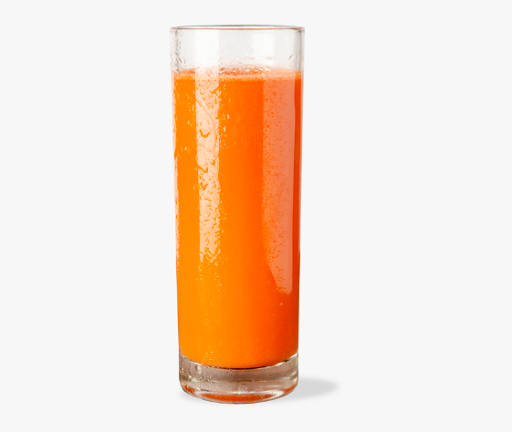
INTEGER
Water
Milk
Juice
1 Litre Bottle

Slide 119


OTHER DATA TYPES
Float – 4 bytes
HOW?
WHY?
Double – 8 bytes
Long Double – 16 bytes

Slide 120
FLOAT
KEYWORD: float
4 BYTES

Slide 121
FLOAT
4 BYTES
SIGN

Slide 122
}
FLOAT
4 BYTES
}
SIGN
Exponent
Fraction

Slide 123
EXAMPLE
172.625
0.625
2
=
+
128
64
32
16
8
4
2
1
*
1.250
EXPONENT: 7
BIAS
1
0
1
0
1
1
0
0
0.250
2
=
0.500
*
+
EXPONENT: 7
127
0.500
2
=
1.000
*
134
10101100.101
*
2⁰
SIGN : 0
1.0101100101
*
2⁷
FRACTION : 1.0101100101
EXPONENT: 10000110

Slide 124
MEMORY MANAGEMENT
DATA TYPE
SIGN
EXPONENT
FRACTION
BIAS
Float
1
8
23
127
Double
1
11
52
1023
Long double
1
15
63
16383

Slide 125
CHARACTER
KEYWORD: char
Character data type allows a variable to store only one character.
#include<stdio.h>
int main()
{
char terv;
terv = 'a' ;
char var = ‘b’ ;
printf("%c \n",terv);
return 0;
}
char terv = ‘a’; //declaration
Variable Declaration
Variable Initialization
Data Type
Variable Name
char terv;
terv = ‘a’;
Constant Value
OUTPUT
Variable Name
a
b
Container named terv holding value ‘a’
‘a’

Slide 126
VARIABLE

Slide 127
VARIABLE
“vary” + “able”
changeable
Variable is name of reserved area allocated in memory. In other words, it is a name of memory location. Variables are used to store information to be referenced and manipulated in a computer program. value of the variable can change, depending on conditions or on information passed to the program. variable="vary + able" that means its value can be changed.

Slide 128


TERV
VERSION

Slide 129



Slide 130



Slide 131
CHARACTER

